Slide 1
Applied Data Science Capstone
The Battle of Neighborhoods
(Course 9 of IBM Data Science Professional Certificate Specialization)
By: Neeraj Tripathi
20 September 2020
Fit Hub Gym Center
Chicago, USA

Slide 2
Business Problem
To select a suitable location for opening up a Gym/Fitness Center in the city of Chicago, Illinois-USA.

Slide 3
Data
1. Data for neighborhoods of chicago along with their zip codes https://www.seechicagorealestate.com/chicago-zip-codes-by-neighborhood.php
2. Data for all zip codes that belong to State of Illinois, USA https://public.opendatasoft.com/explore/dataset/us-zip-code-latitude-and-longitude/download/?format=csv&refine.state=IL
3. Venue data for the above neighborhoods using Foursquare API

Slide 4
Methodology
Collect the data of all the zip codes belonging to Illinois.
Collect the data of all zip codes and corresponding neighborhoods of Chicago
Merge the datasets to obtain the neighborhood data of Chicago along with coordinates.

Slide 5
4. Visualize the neighborhoods on map using folium library to check the correctness of coordinates.
5. Obtain the venue data for each neighborhood present in the dataset using Foursquare API.
6. Preprocess the dataset, group similar venue categories into a single broad category. Drop the non required columns. Exploratory data analysis.

Slide 6
7. Find optimal number of clusters using “elbow method” and KMeans clustering algorithm.
8. Reduce the dimensions of the neighborhood venue frequency dataset to 2 using Principal Component Analysis (PCA).
9. Apply KMeans clustering algorithm on this reduced dataset and visualize the clusters to look for any inconsistencies.

Slide 7
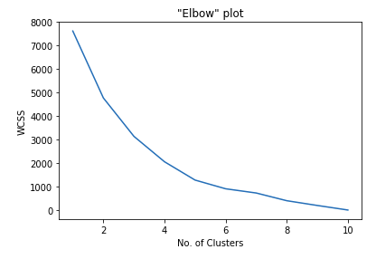
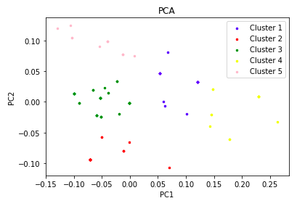
Elbow plot to find optimal number of clusters
2. Plot reduced features (after PCA and clustering)

Slide 8
10. Inspect the number of gyms in the neighborhoods clusterwise by plotting all the gyms belonging to any cluster on the map.
11. Display top few neighborhoods along with the number of gyms for each cluster label.

Slide 9
Results
The neighborhoods of Chicago can be grouped into 5 clusters based on the 10 broad categories described in this project.
Average number of gyms/fitness centers in the neighborhoods that belong to each cluster is different.

Slide 10
Cluster Label | Average number of Gyms in a neighborhood
0 | 2 - 4
1 | 5 - 6
2 | 3 - 5
3 | 2 - 4
4 | 1 - 3

Slide 11
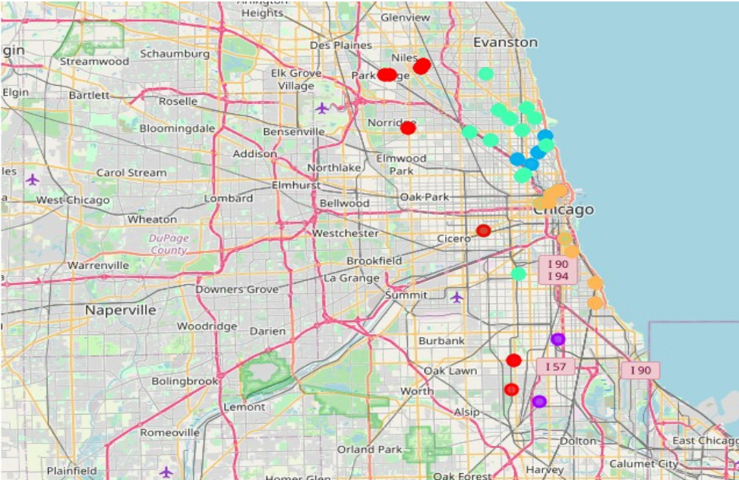
Gyms plotted on map with colors indicating the “cluster labels”.
Blue, purple, green, orange and red colors represent gyms belonging to Cluster 0, 1
2, 3 and 4 respectively.

Slide 12
Observations
On the map, we can see that more and more gyms are located in the northern parts of the city.
Cluster 1 and Cluster 2 (which are the clusters where more than 50% of neighborhoods having more than 6 gyms and 3 gyms respectively) also fall mostly towards the northern parts, indicating a higer level of awareness among people towards health as well as higher competition in gym business in these areas.

Slide 13
Conclusion
1. Aggressive strategy: in Cluster 1 or Cluster 2 neighborhoods
2. Medium risk strategy: in Cluster 0 or Cluster 3 neighborhoods
3. Low risk strategy: in Cluster 4 neighborhoods

